Slide 1
Wali Mohsin 22K-4550 (10,13) Rayyan Alam 22K-4373 (4,9) Ghalib Hussain 22K-4536 (3,5)
BCS-4A

Slide 2

Chapter #04: Interrupts and exceptions
Hafiz Syed Muhammad Rayyan Alam

Slide 3
Exception Handling:
Linux interpret exception raised by CPU as error condition.
Linux produces signals and send them to current process to handle.
SAVING THE REGISTERS FOR THE EXCEPTION HANDLER:
Assembly language exception handlers begin by pushing values onto the stack and jumping to a common error code section.
The error code section saves registers, clears the direction flag, copies the hardware error code, and loads necessary values for handling the exception.
A value of -1 in the stack distinguishes between system call exceptions and others.
The associated high-level C function is invoked, with arguments passed via CPU registers instead of the stack.
ENTERING AND LEAVING THE EXCEPTION HANDLER:
C functions for exception handlers are named with the prefix "do_" followed by the handler’s name.
These functions typically call do_trap() to save hardware error code and exception vector in the process descriptor and send a signal to the current process.
After the handler, the current process handles the signal either in User Mode with its own handler or in Kernel Mode, potentially leading to process termination by the kernel.
Exception handlers distinguish between User Mode and Kernel Mode exceptions, treating them accordingly. Kernel Mode exceptions may be due to invalid system call arguments or kernel bugs.
If a kernel bug is detected, the handler invokes die() to print CPU register contents (kernel oops) and terminates the current process using do_exit().
Upon completion of the exception handling C function, control jumps to ret_from_exception() for further processing.

Slide 4
I/O interrupt handling
Interrupt Vectors:
Interrupt vectors are pointers to interrupt service routines (ISRs).
Each interrupt has a unique vector associated with it, pointing to its corresponding ISR.
Vectors are indexed in the interrupt descriptor table (IDT) in x86 architecture.
IRQ Data Structure:
IRQs (Interrupt Request Lines) are hardware lines used to signal the CPU about device interrupts.
Data structures like the Interrupt Descriptor Table (IDT) or Interrupt Request Descriptor (IRD) manage IRQs.
IRQ Distribution in Multiprocessor System:
In multiprocessor systems, IRQs need to be distributed efficiently among CPUs.
Methods like local APIC (Advanced Programmable Interrupt Controller) are used for IRQ distribution.
Multiple Kernel Mode Stacks:
Each CPU has its own kernel mode stack.
Ensures interrupt handlers don't interfere with each other's data.
Saving the Registers for the Interrupt Handler:
When an interrupt occurs, the CPU saves the current state (registers) before executing the ISR.
Ensures the ISR can safely execute without corrupting the system state.
The do_IRQ() Function:
Kernel function responsible for handling interrupts.
Invoked when an interrupt is raised, handles interrupt processing.
The __do_IRQ() Function:
Low-level function called by do_IRQ() to handle interrupt processing.
Performs basic interrupt handling tasks.
Reviving a Lost Interrupt:
Mechanism to handle interrupts that were missed or lost during processing.
Ensures no interrupt goes unhandled.
Interrupt Service Routines (ISRs):
ISRs are functions executed in response to interrupts.
Perform specific tasks related to the interrupting device.
Dynamic Allocation of IRQ Lines:
Dynamic allocation of IRQ lines allows for flexible assignment of interrupts to devices.
Helps in managing hardware resources efficiently.
Interprocessor Interrupt Handling:
In multiprocessor systems, interrupts may need to be handled by multiple CPUs.
Interprocessor interrupts facilitate communication between CPUs for interrupt handling.

Slide 5
Work queues
Work Queue Data Structure:
Work queues are kernel mechanisms for deferring work to be done later.
Typically implemented as a FIFO (First-In, First-Out) queue.
Each work item encapsulates a function to be executed asynchronously.
Work Queue Functions:
Kernel provides functions to manipulate work queues.
queue_work() is used to enqueue work items into a work queue.
flush_work() is used to wait until all work items in a queue are completed.
The Predefined Work Queue:
The kernel provides a predefined work queue named "system_wq".
It's a global work queue available for general-purpose asynchronous work.
Convenient for tasks that don't require a specific context or priority.

Slide 6
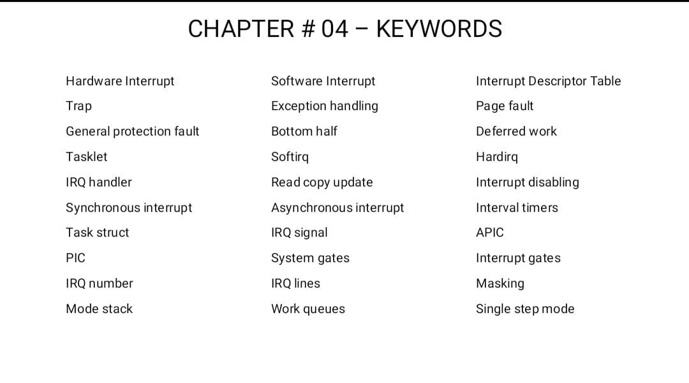

Slide 7
Chapter #09: Process Address Space

Slide 8
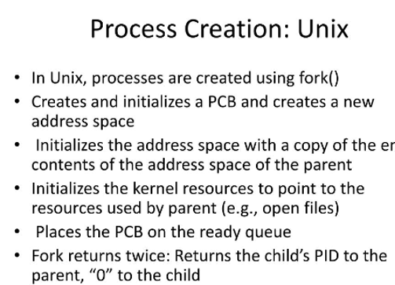
Creating a Process Address space
When a new process is created, the kernel sets up its address space using the copy_mm() function.
This involves creating memory descriptors and setting up page tables.
Forked Processes: Traditional processes inherit their parent's address space and utilize Copy-On-Write (COW) mechanism for efficient memory sharing.
Lightweight Processes: Created with clone() and CLONE_VM flag, these processes share the same address space, reducing overhead.

Slide 9
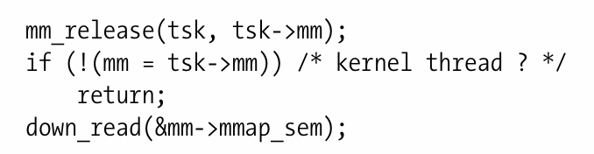
Deleting a Process Address Space
Deleting a Process Address Space
Upon termination, the kernel invokes exit_mm() to release the process's address space.
This involves:
Core Dump Handling: Ensuring synchronization for core dumps if necessary.
Memory Descriptor Release: Releasing memory descriptors, page tables, and related data structures.
The process's address space is not immediately released but is deferred until the process is evicted from the CPU.
This code snippet releases the memory associated with a process when it terminates. It checks if the process is a kernel thread, and if not, it acquires a read lock on the memory mapping semaphore before proceeding with memory cleanup.

Slide 10
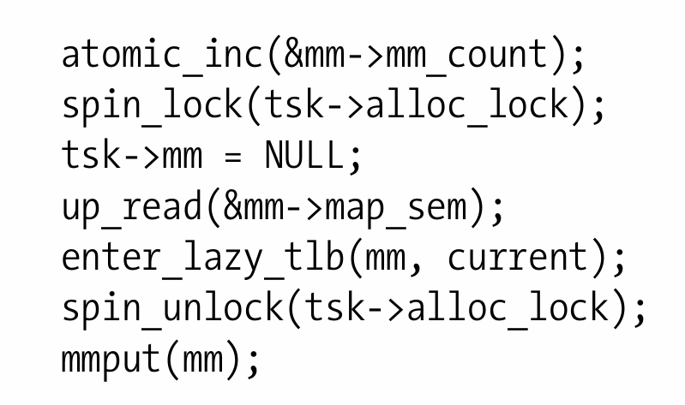
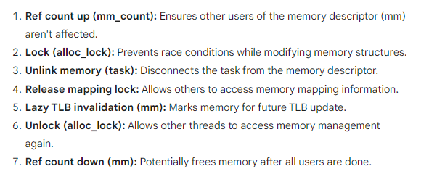
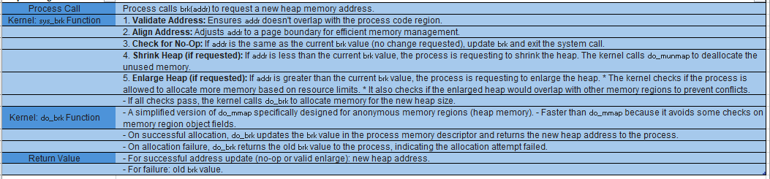
Managing the Heap

Slide 11
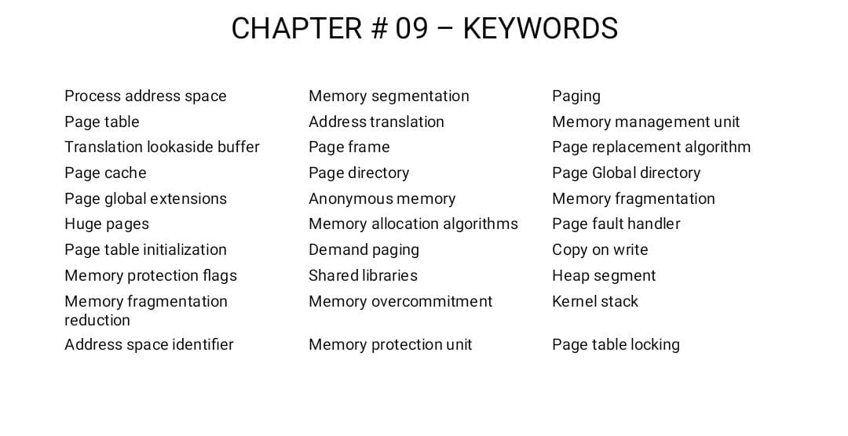

Slide 12

Kernel Synchronization
Syed Ghalib Hussain Zaidi
How the Kernel Services Requests
Synchronization Primitives
Examples of Race Condition Prevention

Slide 13
How the Kernel Services Requests
Kernel Preemption: Ensuring Responsiveness
Managing Synchronization: When and When Not to Use
In the Linux kernel, preemption allows the execution of a running task to be paused, ensuring responsiveness by switching to another task. This reduces latency and enables the kernel to handle time-critical tasks promptly.
Synchronization mechanisms like locks, semaphores, and spinlocks are crucial when multiple processes or threads access shared resources concurrently. They prevent data corruption and ensure consistency. However, synchronization may not be necessary in scenarios involving thread-local data or inherently atomic operations. Avoiding unnecessary synchronization can improve performance by reducing overhead and contention.

Slide 14
Examples of Race Condition Prevention
Reference Counters
Kernel Locking Mechanisms
Reference counters are used to manage the lifecycle of shared resources by tracking the number of references to them. The count is incremented when a resource is referenced and decremented when it is no longer needed. When the count reaches zero, the resource is released.
- The Big Kernel Lock (BKL): A global lock that serializes access to critical sections of the kernel. It prevents race conditions but can lead to scalability issues.
- Memory Descriptor Read/Write Semaphore: A synchronization primitive that protects memory descriptors during read and write operations.
- Slab Cache List Semaphore: A synchronization mechanism that ensures integrity and consistency of slab cache lists.
- Inode Semaphore: Synchronizes access to inodes, maintaining filesystem integrity.

Slide 15
Understanding Synchronization Primitives
Key Synchronization Primitives
Advanced Synchronization Mechanisms
Per-CPU Variables:
Provide each CPU with its own copy of a variable, reducing cache contention and improving performance. They are particularly useful for frequently accessed data by a single CPU, such as statistics or per-CPU counters.
Atomic Operations:
Ensure uninterrupted execution of critical operations by guaranteeing completion without interference, preventing race conditions and ensuring data integrity. Common atomic operations include compare-and-swap (CAS), atomic add, and atomic increment.
Spin Locks:
Protect critical code sections from concurrent access by spinning until the lock becomes available. While simple and efficient in low-contention scenarios, they can lead to performance issues in heavily contended situations.
Memory Barriers:
Ensure proper ordering of memory accesses and prevent optimizations that could lead to data inconsistency. They are essential for maintaining memory coherence and enforcing synchronization between CPUs, especially in multi-threaded and multi-core systems.

Slide 16
Word Cloud
Interrupts,Synchronization Primitives,Race Conditions,Spinlocks,Mutexes,Semaphores,
Critical Sections,Deadlocks,Concurrent Access,Atomic Operations,Thread Safety,
Context Switching,Kernel Threads,Locking Mechanisms,Wait Queues,Parallel Processing,
Shared Resources,Scheduling Algorithms,Real-Time Systems,Priority Inversion,Kernel Preemption,
Spinlock Contention,Lock-Free Algorithms,Memory Barriers,Cache Coherency,Thread Synchronization,
Inter-Process Communication,Tasklets,Per-CPU Variables,Data Corruption Prevention

Slide 17
Processes
Process Descriptor:
Process Switch:
Creating a Process:

Slide 18
Process Descriptor
Identifying and Handling Processes
Process Descriptors and Organization
Each process is identified by a unique Process ID (PID). Processes are organized into a doubly linked list, with separate lists for processes in the TASK_RUNNING state. Relationships among processes can be established through parent-child relationships.
Process descriptors handle the identification and management of processes. The current process is identified by the current macro. Processes are organized in the pidhash table for efficient lookup. Wait queues are used to handle processes waiting for specific events.

Slide 19
Process Switch
Hardware Context and Process Switching
Utilizing FPU, MMX, and SSE/SSE2 Units in Kernel Mode
Hardware context includes registers and other processor state information. The Task State Segment (TSS) contains information about tasks, such as privilege levels and hardware context. Each process has a thread field that holds information about the associated thread. During a process switch, the __switch_to() function is responsible for performing the actual switch, while the FPU, MMX, and XMM registers are saved and loaded to maintain their state.
In kernel mode, the FPU, MMX, and SSE/SSE2 units can be utilized for specific operations. These units provide additional capabilities for performing mathematical and multimedia tasks efficiently.

Slide 20
Creating Process
System Calls for Process and Thread Creation
The do_fork() Function
The clone(), fork(), and vfork() system calls are used to create new processes or threads. These calls allow for the creation of independent execution contexts within a program.
The do_fork() function is responsible for creating a new process. It is a crucial part of the process creation mechanism in the kernel and handles the necessary steps to duplicate the existing process.

Slide 21
Word Cloud:
Process Management, Process Creation,Process Termination,Process States
Process Scheduling,Process Control Block (PCB),Context Switching,Process ID (PID),Parent Process,Child Process
Process Communication,Inter-Process Communication (IPC),Process Synchronization
Process Execution,Process Priority
Process Suspension,Process Resumption
Process Forking,Process Joining,Process Termination Signals
Process Resources,Process Memory Management
Process Threads,Lightweight Processes (LWP)
Process Switching,Process Creation System Calls,Process Termination System Calls
Process Scheduling Algorithms,Process Deadlocks,Process Scheduling Policies

Slide 22
Syed Wali Mohsin Naqvi Chapter 10: System Calls

Slide 23
POSIX APIs and System Calls
API vs. System Call:
API: Function definition specifying service access, often in libraries like libc.
System Call: Direct request to kernel via software interrupt, typically through wrapper routines.
Wrapper Routines:
Correspond to system calls, define API for applications.
May add functionality or error handling.
API Implementation:
APIs can be in User Mode, may make multiple system calls.
POSIX certification focuses on API provision, not system call specifics.
Error Handling:
Wrapper routines return integer values, -1 often indicates failure.
Error codes stored in errno variable, defined in libc.
Portability:
Error code macros specified by POSIX.
Linux defines macros in specific header files for C program portability among Unix systems.

Slide 24
System Call Handler and Service Routines
Invoking a System Call:
When a User Mode process calls a system call, CPU switches to Kernel Mode and starts executing a kernel function.
Two methods to invoke a Linux system call, both lead to the system call handler.
System call number (passed via the eax register) identifies the required system call.
Return Values:
All system calls return an integer value.
Positive or 0 values denote successful termination, negative values denote error conditions.
Error code (negation of error code) returned to application program via errno variable, handled by wrapper routines.
System Call Handler:
Saves most register contents in Kernel Mode stack, invokes corresponding C function (system call service routine).
Exits handler by loading saved register values and switching CPU back to User Mode.
Service Routine Naming:
Conventionally named sys_xyz(), with exceptions.
Associated with each system call number, stored in a dispatch table (sys_call_table).
Dispatch Table:
Kernel uses sys_call_table array to associate each system call number with its service routine.
Contains NR_syscalls entries, each entry holding the service routine address for the corresponding system call number.
NR_syscalls Macro:
Static limit on maximum implementable system calls.
Does not indicate the actual number of implemented system calls.
Unused entries in the dispatch table point to sys_ni_syscall(), returning -ENOSYS error code for non-implemented system calls.

Slide 25
Entering and Exiting a System Call
Invoking a System Call:
Native applications can invoke a system call in two ways:
Using the `int $0x80` assembly language instruction, historically used in older Linux kernels.
Using the `sysenter` assembly language instruction, introduced in Intel Pentium II processors and supported by Linux 2.6 kernel.
Exiting a System Call:
Kernel can exit from a system call, switching CPU back to User Mode, in two ways:
Using the `iret` assembly language instruction.
Using the `sysexit` assembly language instruction, introduced in Intel Pentium II processors along with `sysenter`.
Challenges:
Supporting both entry methods:
Kernel must support older libraries using `int $0x80` and newer ones using `sysenter`.
Standard library using `sysenter` must be compatible with older kernels supporting only `int $0x80`.
Compatibility required for processors with and without `sysenter` instruction.
Compatibility Solutions:
Kernel and standard library must run on both older processors without `sysenter` and newer ones with it.
Linux kernel addresses these compatibility issues, as discussed later in the chapter.

Slide 26
Keywords
System Calls
Kernel Mode
Parameter Passing
User Mode
CPU registers
80 × 86 processors
API
System call handler
Exception handlers
System call number
POSIX standard
Compatibility mode
Local Descriptor Table
iBCS and Solaris/x86 programs
System call invocation
Kernel wrapper routines
_syscall0 through _syscall6
Dynamic Address Checking
Paging Unit
Physical address
Linear address
Fix-up code
Assembly language instructions
System call return values
Error codes
Process heap
Memory allocation
Process threads
System call parameters
System call compatibility

Slide 27
I/O Architecture and Device Drivers
Chapter:13

Slide 28
I/O Architecture
Data Paths and Buses:
Data paths facilitate information flow between CPU(s), RAM, and connected I/O devices.
Buses act as primary communication channels inside the computer.
System Bus:
Connects most internal hardware devices.
Common system bus types include PCI (Peripheral Component Interconnect), ISA, EISA, MCA, SCSI, and USB.
Multiple buses of different types may be present in a computer, interconnected by bridges.
High-Speed Buses:
Front side bus connects CPU to RAM controller.
Backside bus connects CPUs directly to external hardware cache.
Host bridge links system bus and front side bus.
I/O Device Hosting:
Each I/O device is hosted by one bus, affecting device's internal design and kernel handling.
Functional characteristics discussed here apply to all PC architectures, without specifying a particular bus type.
I/O Bus:
Data path connecting CPU to I/O device.
80 × 86 microprocessors use 16 address pins and 8, 16, or 32 data pins to address and transfer data to I/O devices.
I/O bus connects to each I/O device via a hierarchy of hardware components: I/O ports, interfaces, and device controllers.

Slide 29
I/O Ports
I/O Ports:
Each device connected to the I/O bus has its own set of I/O addresses, called I/O ports.
In IBM PC architecture, up to 65,536 8-bit I/O ports are available.
Consecutive 8-bit ports can be combined into single 16-bit or 32-bit ports, starting on even addresses or multiples of 4, respectively.
Special assembly language instructions (`in`, `ins`, `out`, `outs`) allow CPU to read from and write into I/O ports.
Mapped I/O:
I/O ports can also be mapped into addresses of the physical address space.
CPU communicates with I/O device using memory instructions (`mov`, `and`, `or`, etc.), offering faster access and compatibility with DMA.
Unified I/O Programming:
I/O ports structured into specialized registers for each device.
CPU writes commands to device control register, reads device state from status register, and exchanges data with input and output registers.
Accessing I/O Ports:
Assembly language instructions (`in`, `out`, `ins`, `outs`) used to access I/O ports.
Kernel provides auxiliary functions (`inb()`, `outb()`, `inw()`, etc.) to simplify I/O port accesses, with and without pauses.
Resource Management:
Kernel tracks I/O ports assigned to each hardware device using "resources."
Resource represents a range of I/O port addresses, stored in a tree-like data structure.
Device drivers use functions (`request_resource()`, `allocate_resource()`, `release_resource()`) to manage assigned resources.
Kernel Functions:
`request_region()` assigns an interval of I/O ports to a device.
`allocate_resource()` finds and assigns an available range in the resource tree.
`release_region()` releases a previously assigned interval of I/O ports.
File Representation:
Information about all assigned I/O addresses stored in `/proc/ioports` file.

Slide 30
I/O Interfaces
I/O Interface:
Hardware circuit between I/O ports and device controller.
Translates values in I/O ports into commands and data for device, detects device state changes.
Types of Interfaces:
Custom I/O Interfaces:
Devoted to specific hardware device.
Device controller often located on same card as interface.
Devices can be internal (inside PC cabinet) or external (outside PC cabinet).
General-Purpose I/O Interfaces:
Connect multiple hardware devices.
Typically used for external devices.
Examples of Custom I/O Interfaces:
Keyboard Interface:
Graphic Interface:
Disk Interface:
Bus Mouse Interface:
Network Interface:
Examples of General-Purpose I/O Interfaces:
Parallel Port:
Serial Port:
PCMCIA Interface:
SCSI Interface:
USB (Universal Serial Bus):

Slide 31
Keywords
I/O Architecture
Device Drivers
Virtual File System
80 × 86 I/O architecture
Linux device driver model
Device Files
Character Device Drivers
Block Device Drivers
I/O Port
I/O Interface
I/O Device
I/O Controller
Floppy disk
First IDE disk
Device Files
Device Drivers
The Device Driver Model
Examples of device files
Major and Minor numbers
Hardware device
Device controller
I/O interface
External device
Bus slots
Card connector
External cable
VFS (Virtual File System)
Kernel operations
Application programs
Linux operating system

